Slide 2
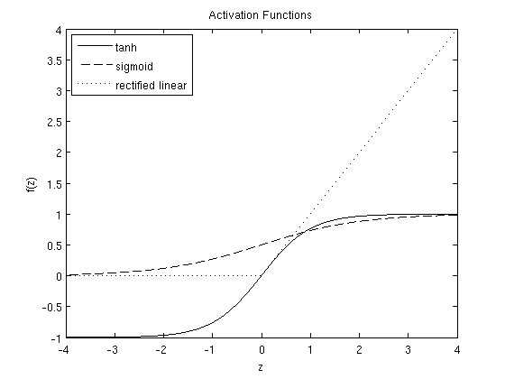


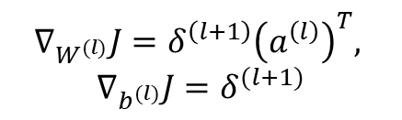







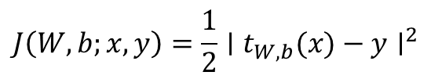





$$Forward propagation$$
$$Cost function$$
$$z^{(l+1)}=W^{(l)}a^{(l)}+b^{(l)}$$
$$a^{(l+1)}=f\left(z^{\left(l+1\right)}\right)$$
$$(one−half) squared −error cost function$$
$$J\left(W,b;x, y\right)=\frac{1}{2}∣t_{W,b}(x)−y∣^{2}$$
$$Simple FFP arquitecture$$
$$Input and bias units$$
$$W^{(1)}∈ℝ^{2×2}$$
$$W^{(2)}∈ℝ^{1×2}$$
$$Input layer$$
$$Hidden layer$$
$$Output layer$$
$$Backpropagation$$
$$∇_{W^{(l)}}J=δ^{\left(l+1\right)}{\left(a^{\left(l\right)}\right)}^{T},$$
$$∇_{b^{(l)}}J=δ^{(l+1)}$$
$$a_{i}^{\left(l=1\right)}=x_{i}$$
$$a_{i}^{\left(l=2\right)}$$
$$Activation$$

